Slide 1
Bazel

Slide 2
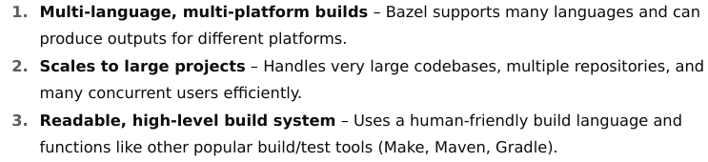
Intro to Bazel
Bazel is an open-source build and test automation tool developed by Google.
It's designed to handle large, complex software projects with multiple languages and platforms, ensuring fast, reproducible, and correct builds.

Slide 3
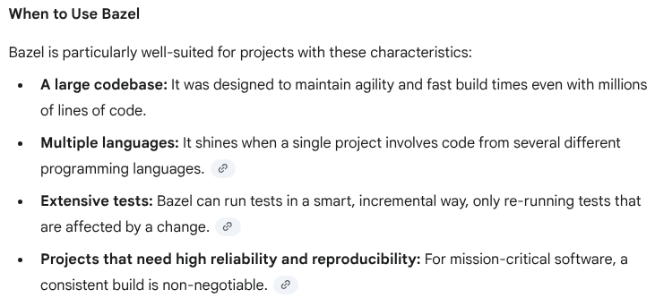

Slide 4
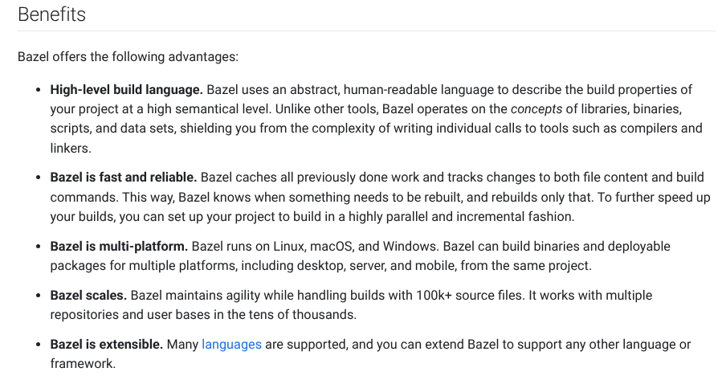

Slide 5
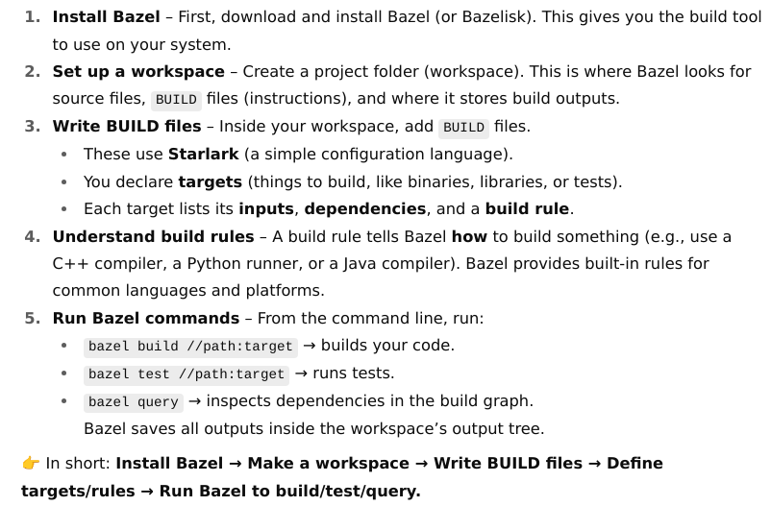
Using Bazel

Slide 6
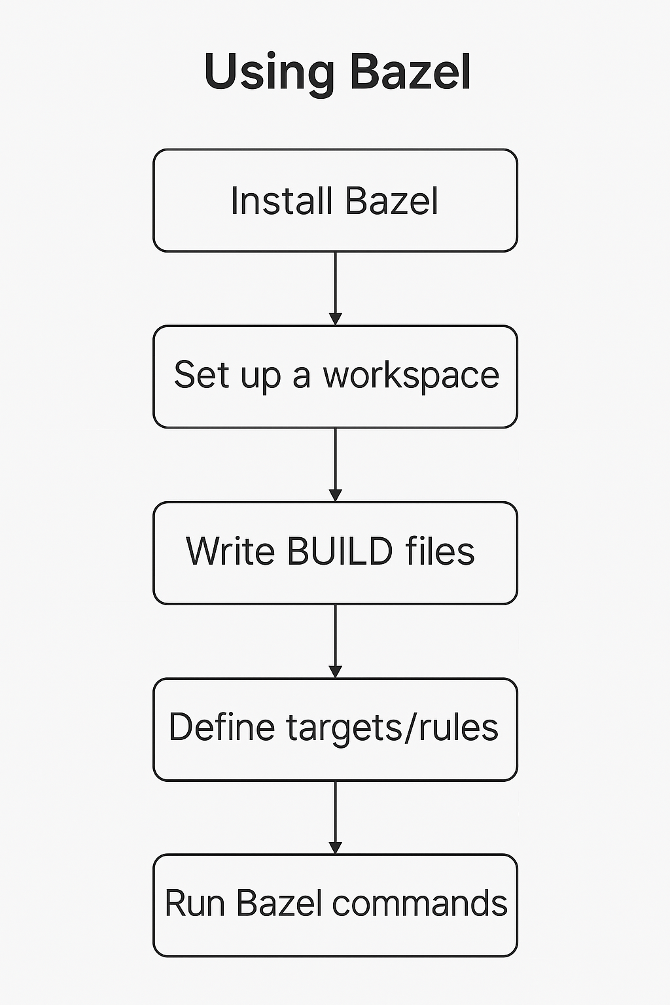

Slide 7
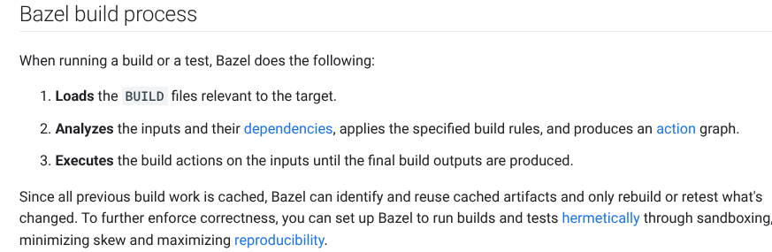

Slide 8
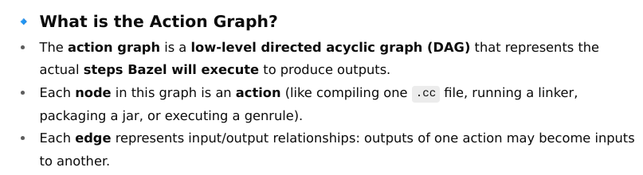
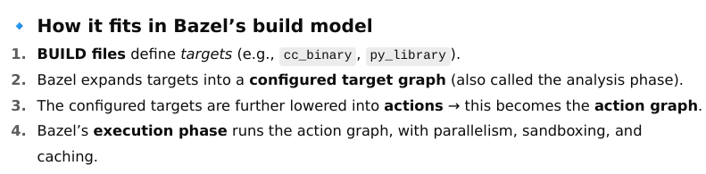
Action Graph
action graph is one of the core internal concepts that explains how Bazel executes your build.

Slide 9
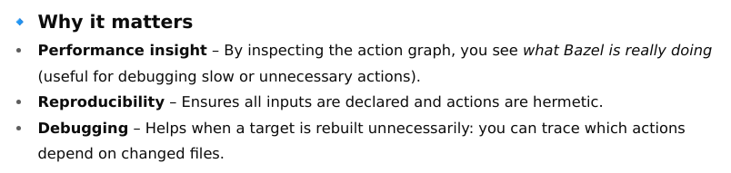
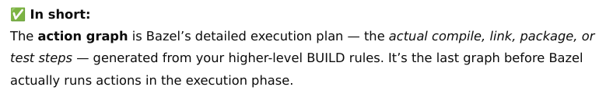

Slide 10
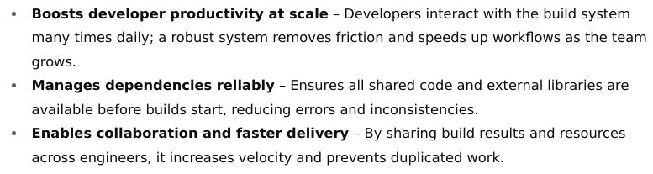
Build Basics

Slide 11
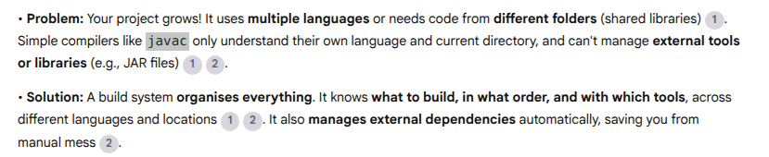
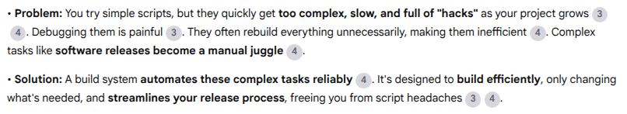
Why a Build System?
5 Key reasons
Compilers Alone Can't Handle Complexity
Shell Scripts Become a Maintenance Headache

Slide 12
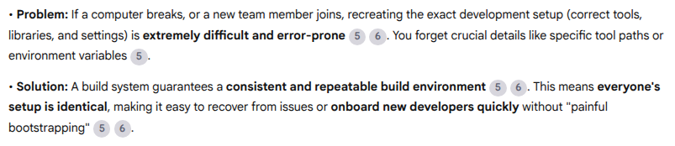
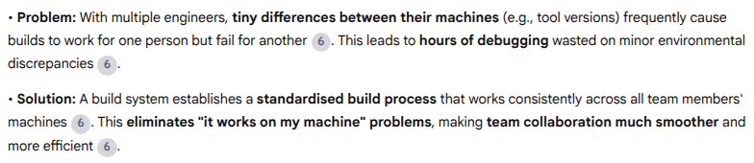
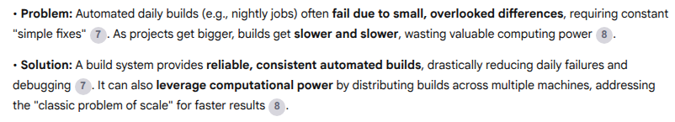
Ensure Consistent & Reproducible Environments
Smooth Team Collaboration
Reliable Automation & Scalable Performance

Slide 13
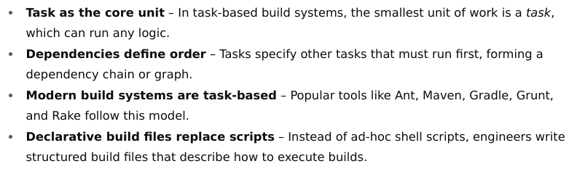
Task-Based Build Systems
Understanding task-based build systems

Slide 14
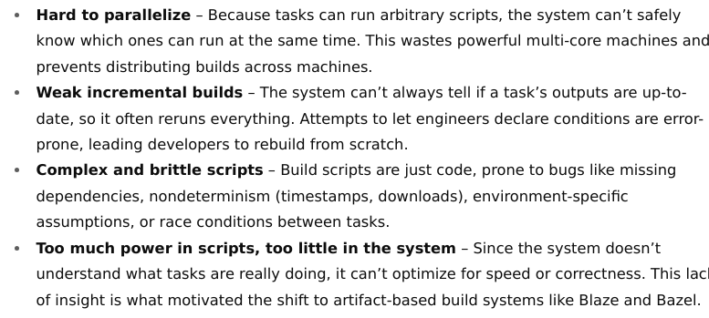
Dark side of task-based build systems

Slide 15
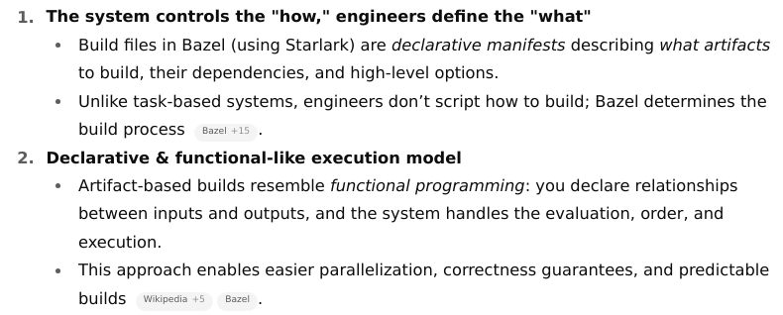
Artifact-Based Build Systems

Slide 16
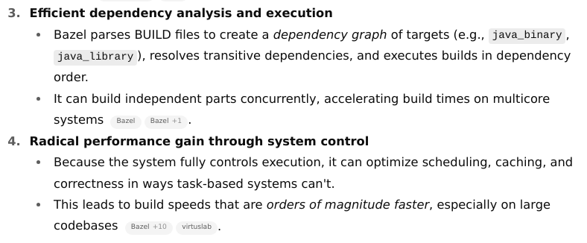
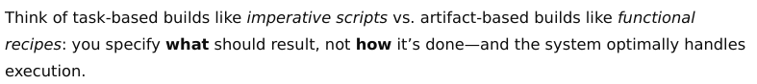

Slide 17
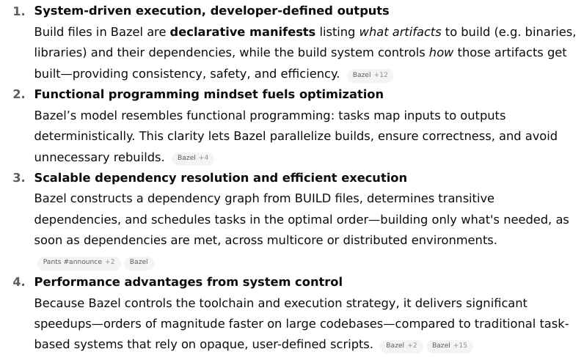
Artifact-Based Build Systems (e.g., Bazel)

Slide 18
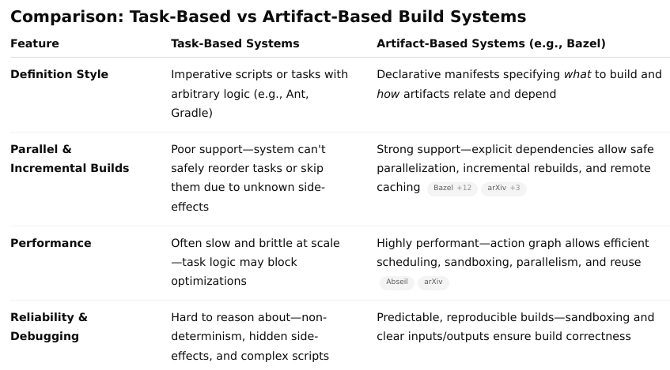
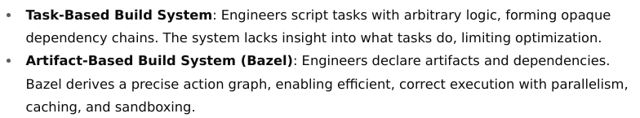

Slide 19
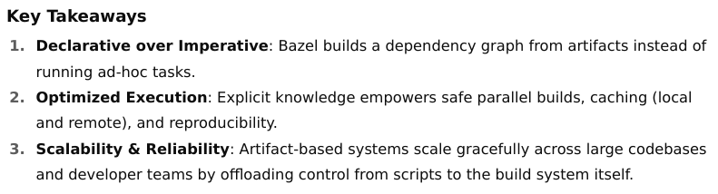

Slide 20
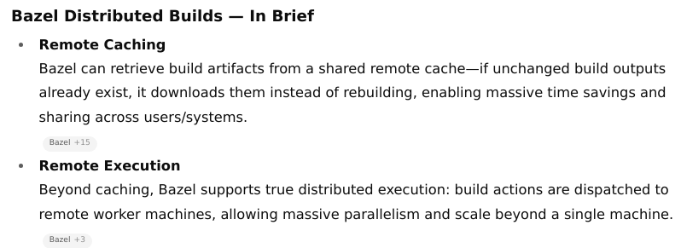
Distributed Builds

Slide 21
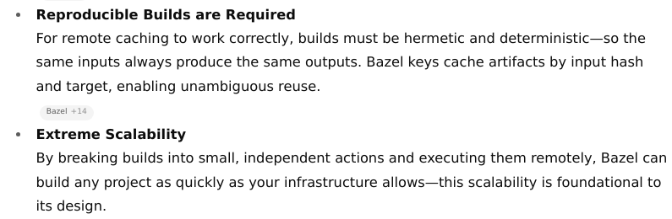

Slide 22
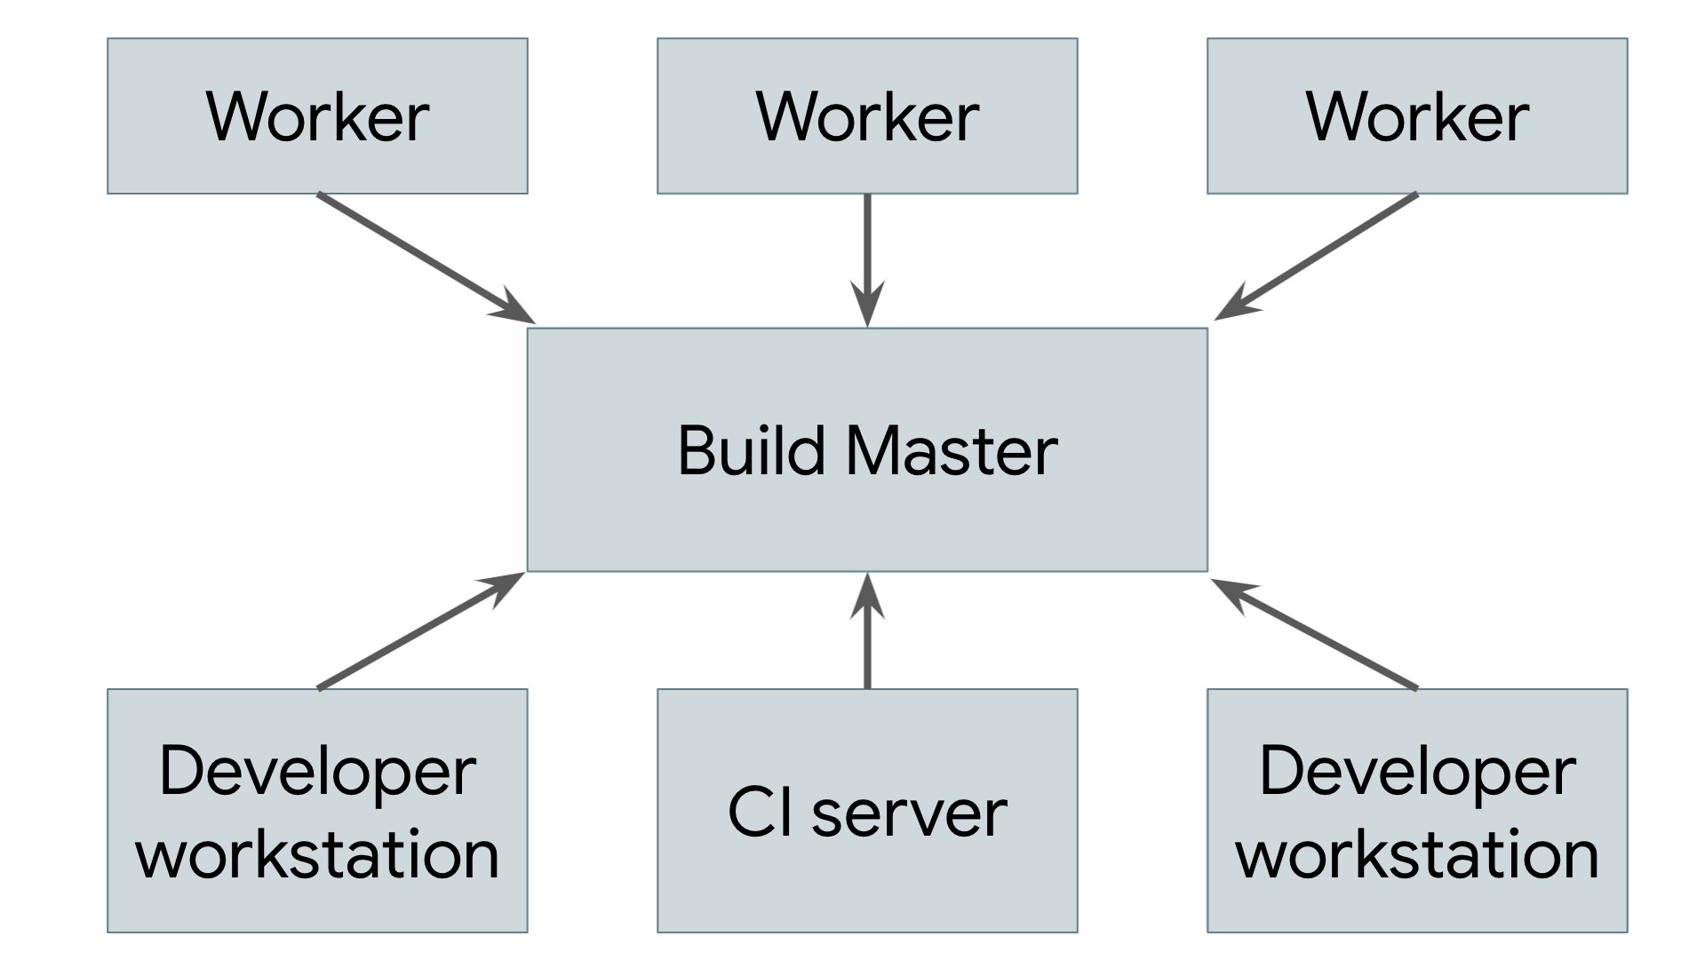
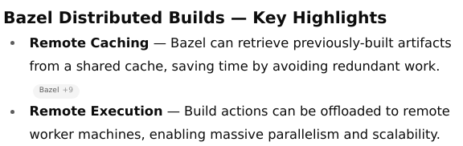
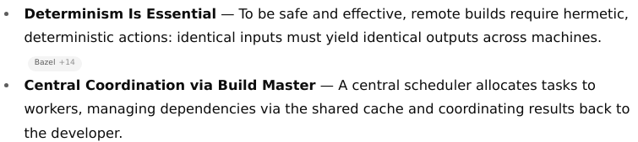

Slide 23
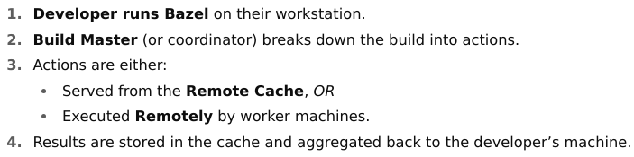
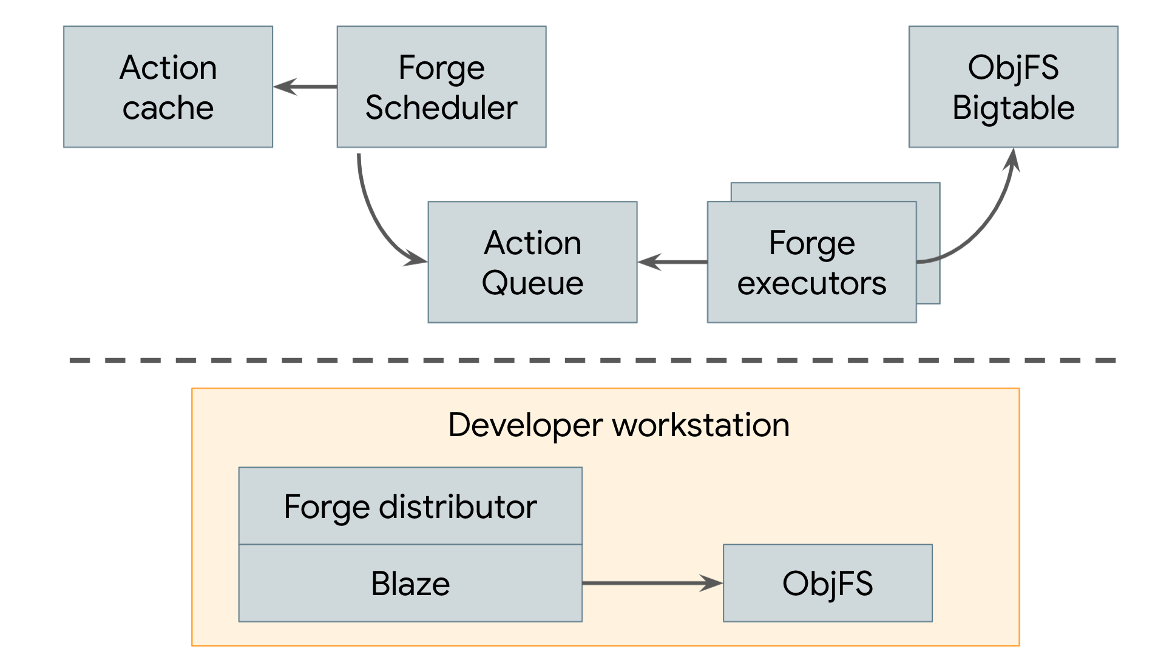
Distributed builds at Google

Slide 24
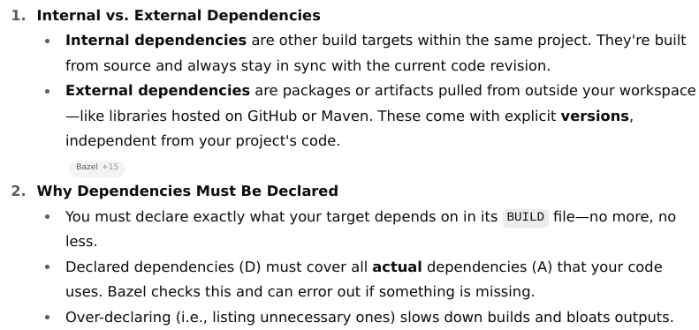
Dependency Management

Slide 25
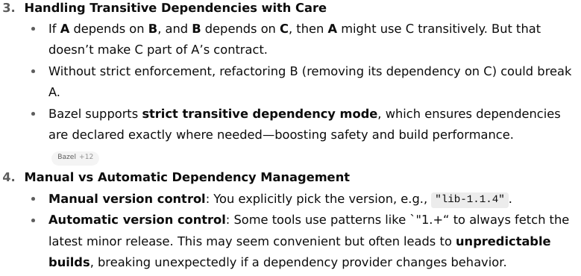

Slide 26
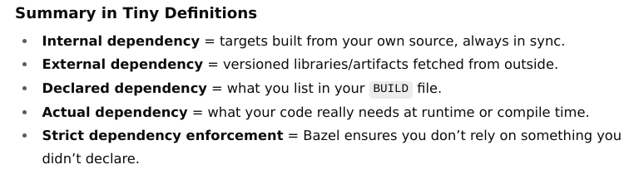

Slide 27
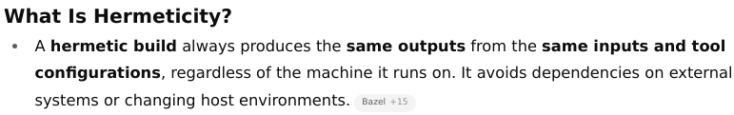
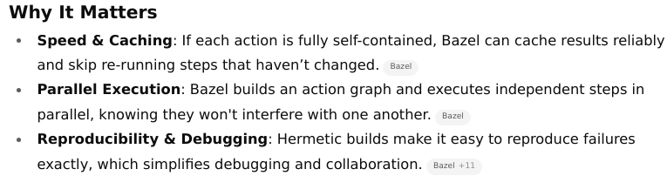
Hermeticity

Slide 28
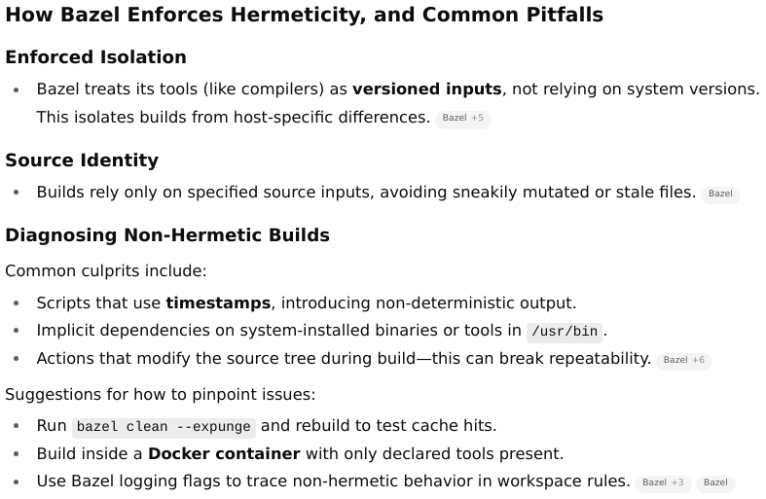

Slide 29
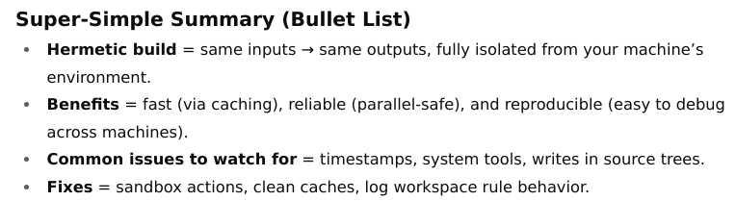
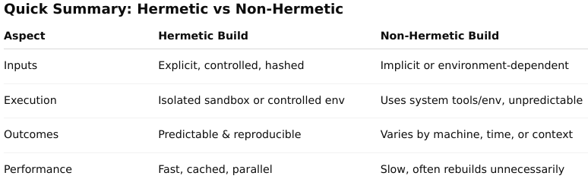

Slide 30

Concepts

Slide 31
Repositories,
workspaces,
packages, and
targets

Slide 32
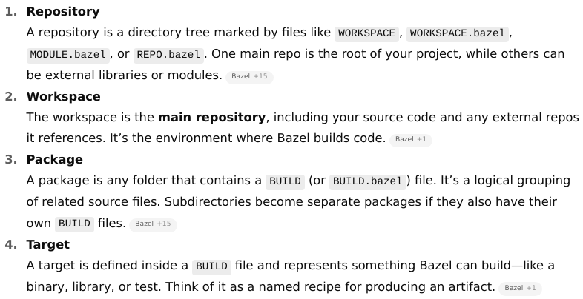

Slide 33
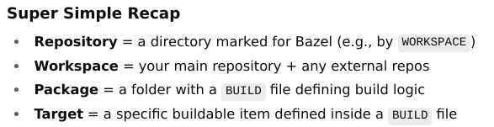
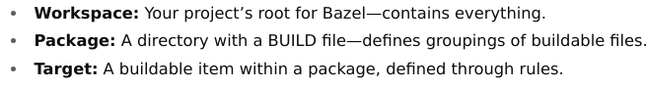

Slide 34
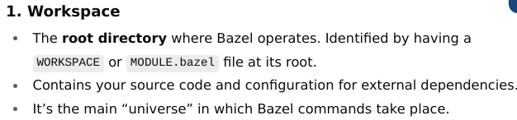
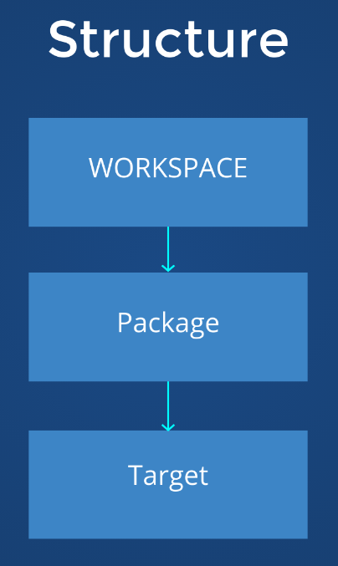
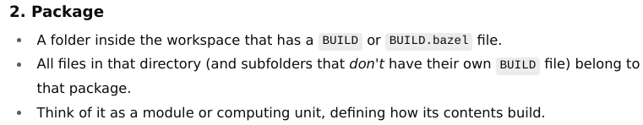
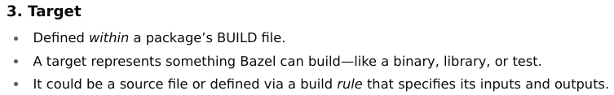
Bazel’s Structural Hierarchy

Slide 35
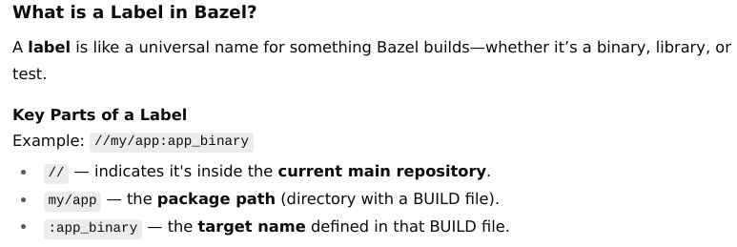
Labels

Slide 36
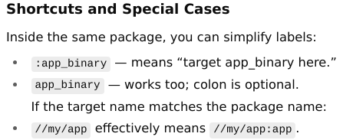
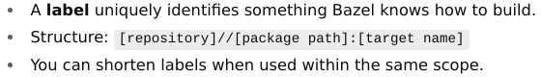

Slide 37

BUILD files

Slide 38


Slide 39


the cc_binary rule creates a binary target that depends on the hello_cc library.

Slide 40

Loading an extension

Slide 41



Slide 42





Slide 43


Slide 44


Slide 45
Types of build rules

Slide 46


Slide 47



Slide 48



Slide 49



Slide 50


Slide 51
Dependencies

Slide 52


Dependency Declaration Pitfalls

Slide 53


Slide 54


Slide 55
Types of Dependencies in Bazel

Slide 56



Slide 57



Slide 58



Slide 59


Slide 60

Using Labels to Reference Directories in data

Slide 61



Slide 62



Slide 63



Slide 64


Slide 65
Visibility

Slide 66


Target visibility

Slide 67


If client is not included, this load would fail.
Add "public" for wide access, or "private" for same-package-only.

Slide 68

Refer mm - visibility.png

Slide 69


Platforms & Toolchains
Result: You can tell Bazel “build this target for ARM64 Linux” by selecting that platform.

Slide 70



Slide 71



Slide 72



Slide 73


Slide 74
Bazel : Build a C++ Project

Slide 75





Stage 1 single target, single package
bazel build //main:hello-world
bazel-bin/main/hello-world

Slide 76





Stage2 : multiple build targets
bazel build //main:hello-world
bazel-bin/main/hello-world

Slide 77


Slide 78









Stage3 multiple packages

Slide 79

bazel build //main:hello-world
bazel-bin/main/hello-world

Slide 80






Stage 4

Slide 81
C++ Build Use Cases

Slide 82

How do we -
Including multiple files in a target

Slide 83

Using transitive includes

Slide 84




Slide 85

Adding include paths

Slide 86



Use Case: Legacy Library

Slide 87





Include external libraries

Slide 88



Adding dependencies on precompiled libraries

Slide 89
Bazel : Configure C++ Toolchains

Slide 90




Slide 91


Slide 92



Slide 93

bazel build //main:hello-world --toolchain_resolution_debug=@bazel_tools//tools/cpp:toolchain_type

Slide 94


Review the dependency graph
sudo apt update && sudo apt install graphviz xdot

Slide 95
Remote Execution

Slide 96


Slide 97


Slide 98


Slide 99


Slide 100


Slide 101


Slide 102
Mini setup to try Remote Cache only

Slide 103


Slide 104





Slide 105




Slide 106



Slide 107


Slide 108
Configurable Build Attribute

Slide 109


Slide 110


Slide 111


Slide 112




Slide 113






Slide 114






Slide 115
Custom Rules
and
Macros

Slide 116


Slide 117
Use Case Example: A Python Code Generator 🐍

Slide 118




Slide 119





Slide 120




Slide 121






Slide 122


Slide 123


Stage 9_py-bazel-demo

Slide 124





Stage 9_py-bazel-demo

Slide 125




Slide 126


Slide 127
Query quickstart

Slide 128
Conan, software package manager

Slide 129


Slide 130


Slide 131



Slide 132


Slide 133



Slide 134


Slide 135



Slide 136


Slide 137


Slide 138


Slide 139


